Slide 1
Public Opinion of Democracy in Africa
Andy Ouyang
Final Presentation for 99-520C, July 10, 2024
Notes:
Main title: 40 pt. Arial
Presenter Name: 16 pt. Arial
Presenters Title: 16 pt. Arial Italic

Slide 2
Data Analysis of Public Opinion Data
Afrobarometer Data Gathering
Finding relevant questions in the Afrobarometer survey codebook
Matching questions across the different years the survey has been distributed over
Data Visualization in R
Recoding data into numerics from words
Removing unnecessary data (missing, refused to answer, don’t know responses to questions)
Making bar graphs showing the mean response and most recent survey response distribution
Improving Visualizations
Over time visualizations improved through using stacked bar graphs to show distributions changing over time
Notes:
better shows the two sides of the agreement spectrum as well as any neutral stances

Slide 3
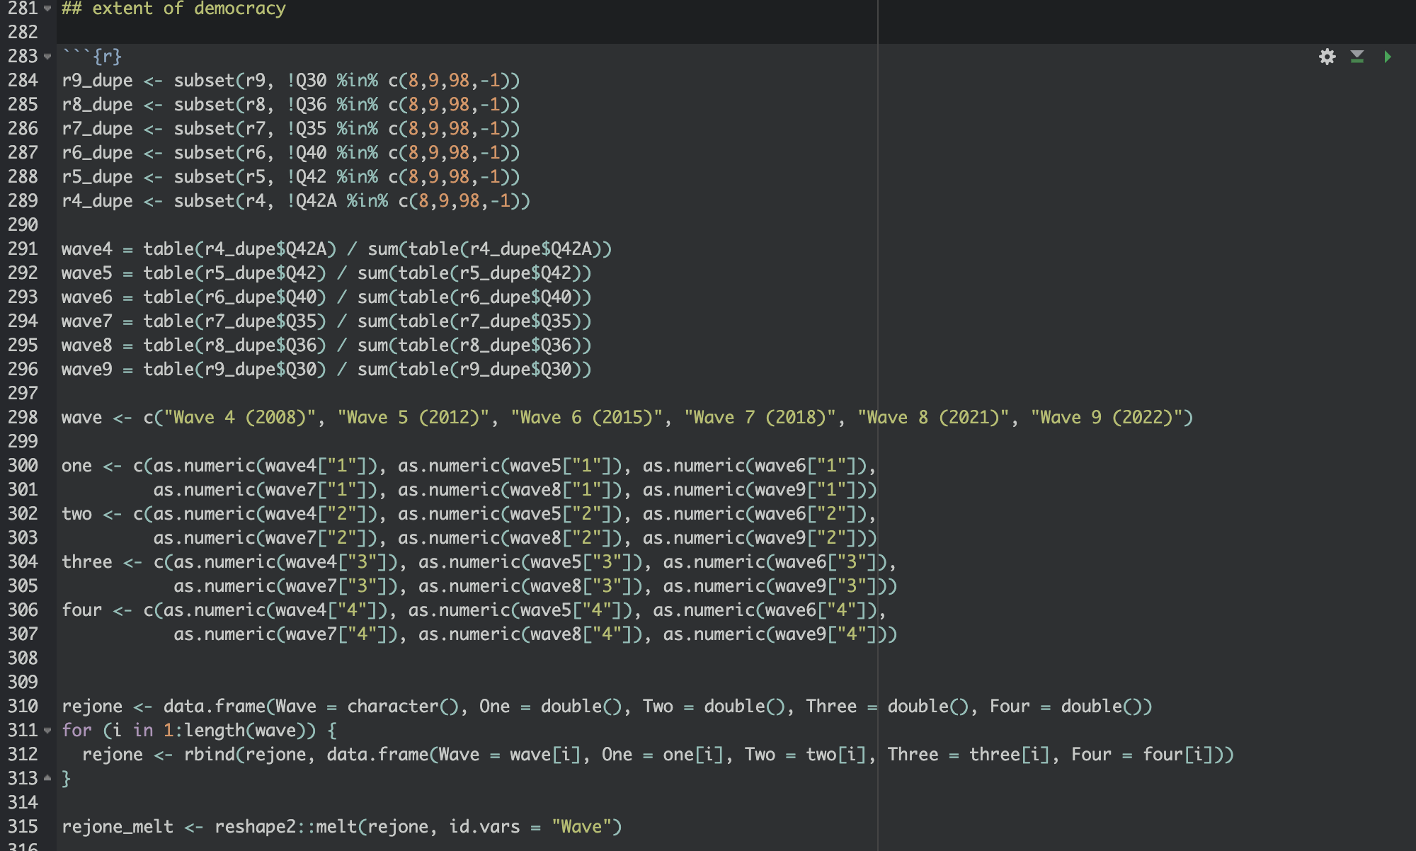
R Code

Slide 4
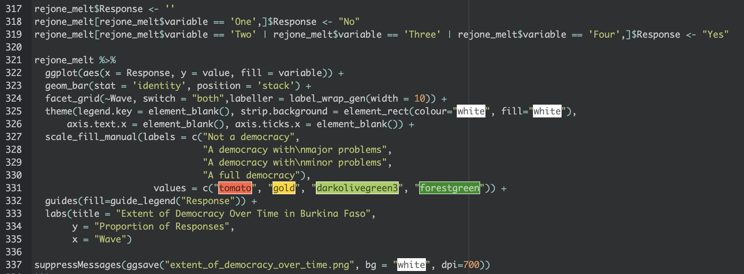
R Code

Slide 5
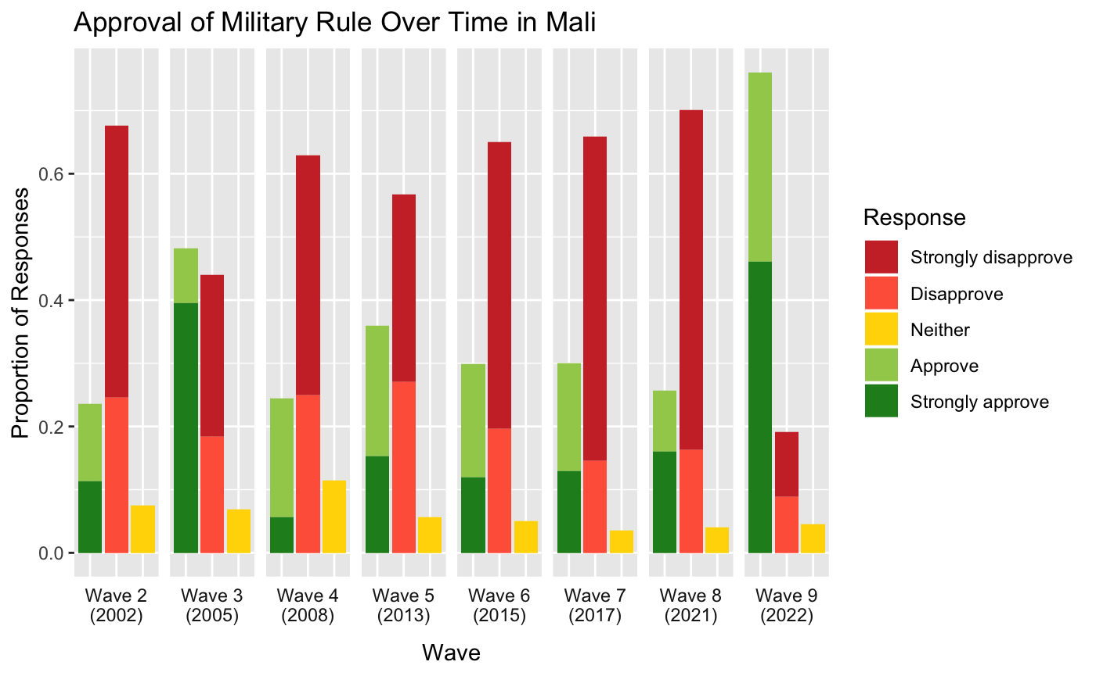
Mass support for military rule has exploded in Mali.

Slide 6
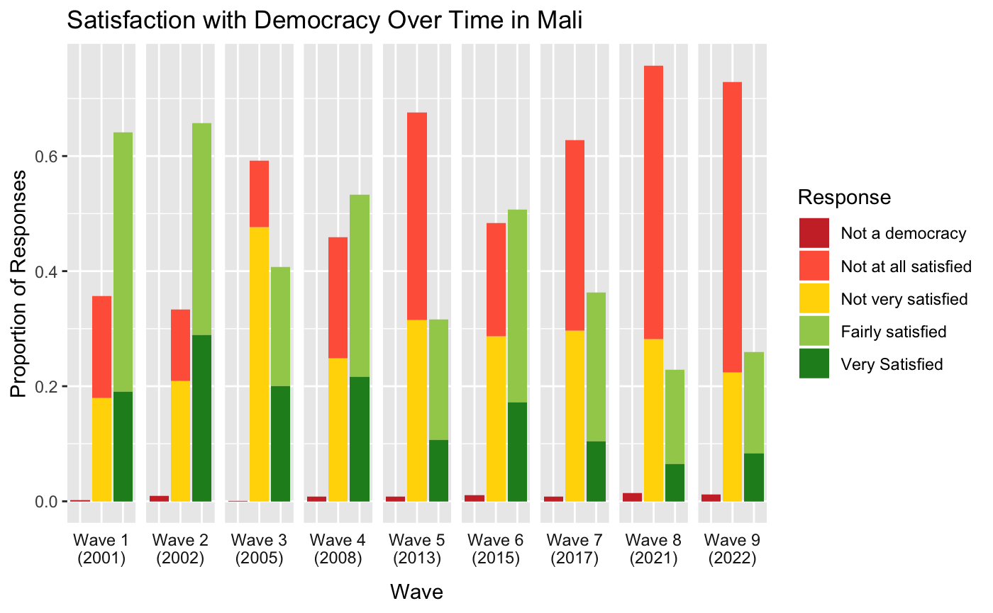
Increasing dissatisfaction with democracy but…

Slide 7
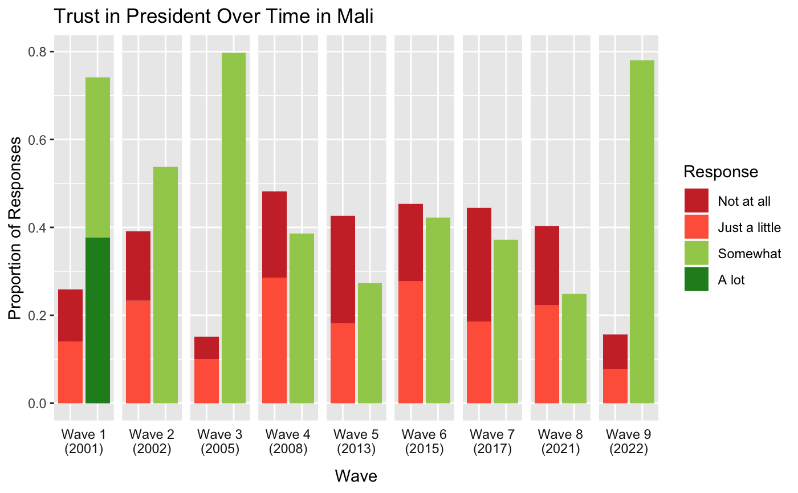
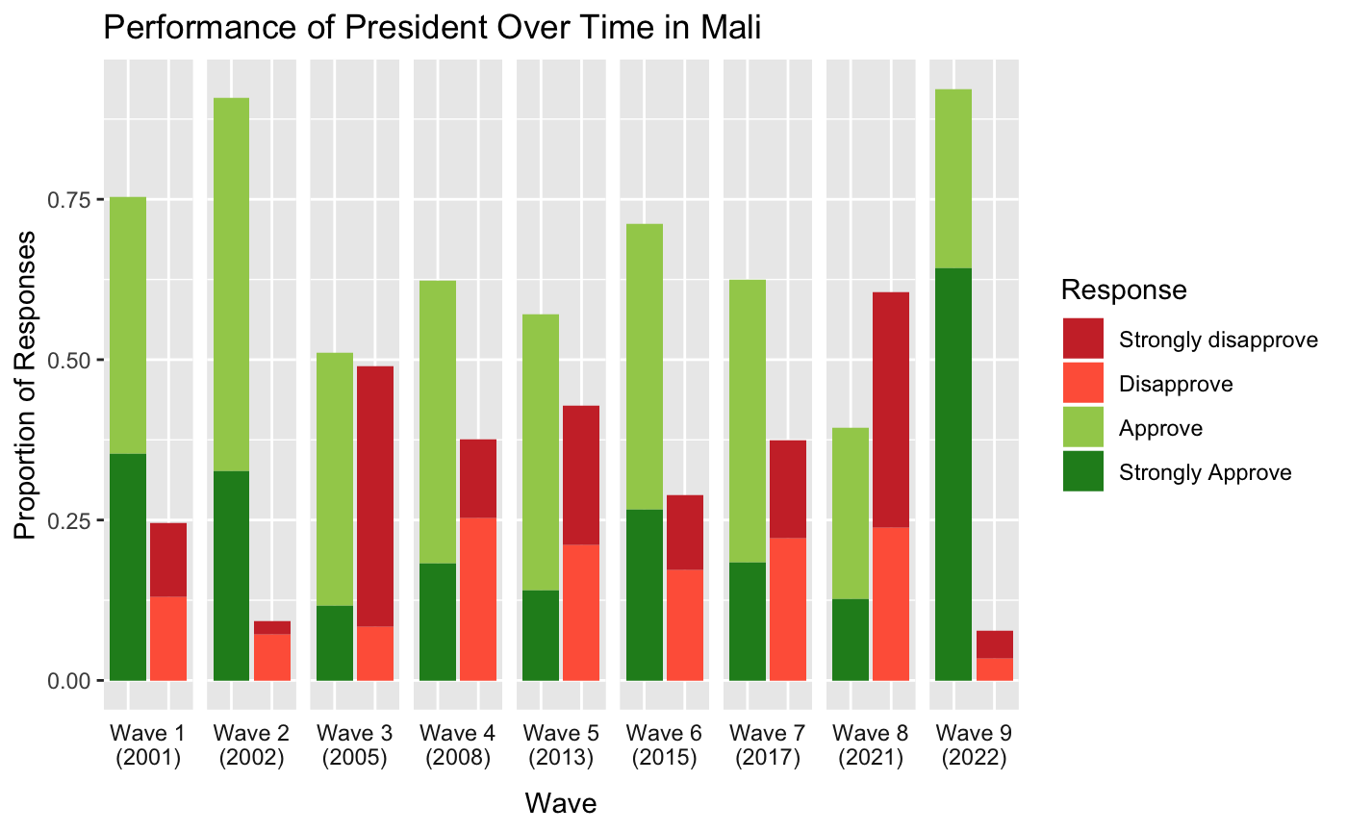
… increasingly positive opinions regarding president

Slide 8
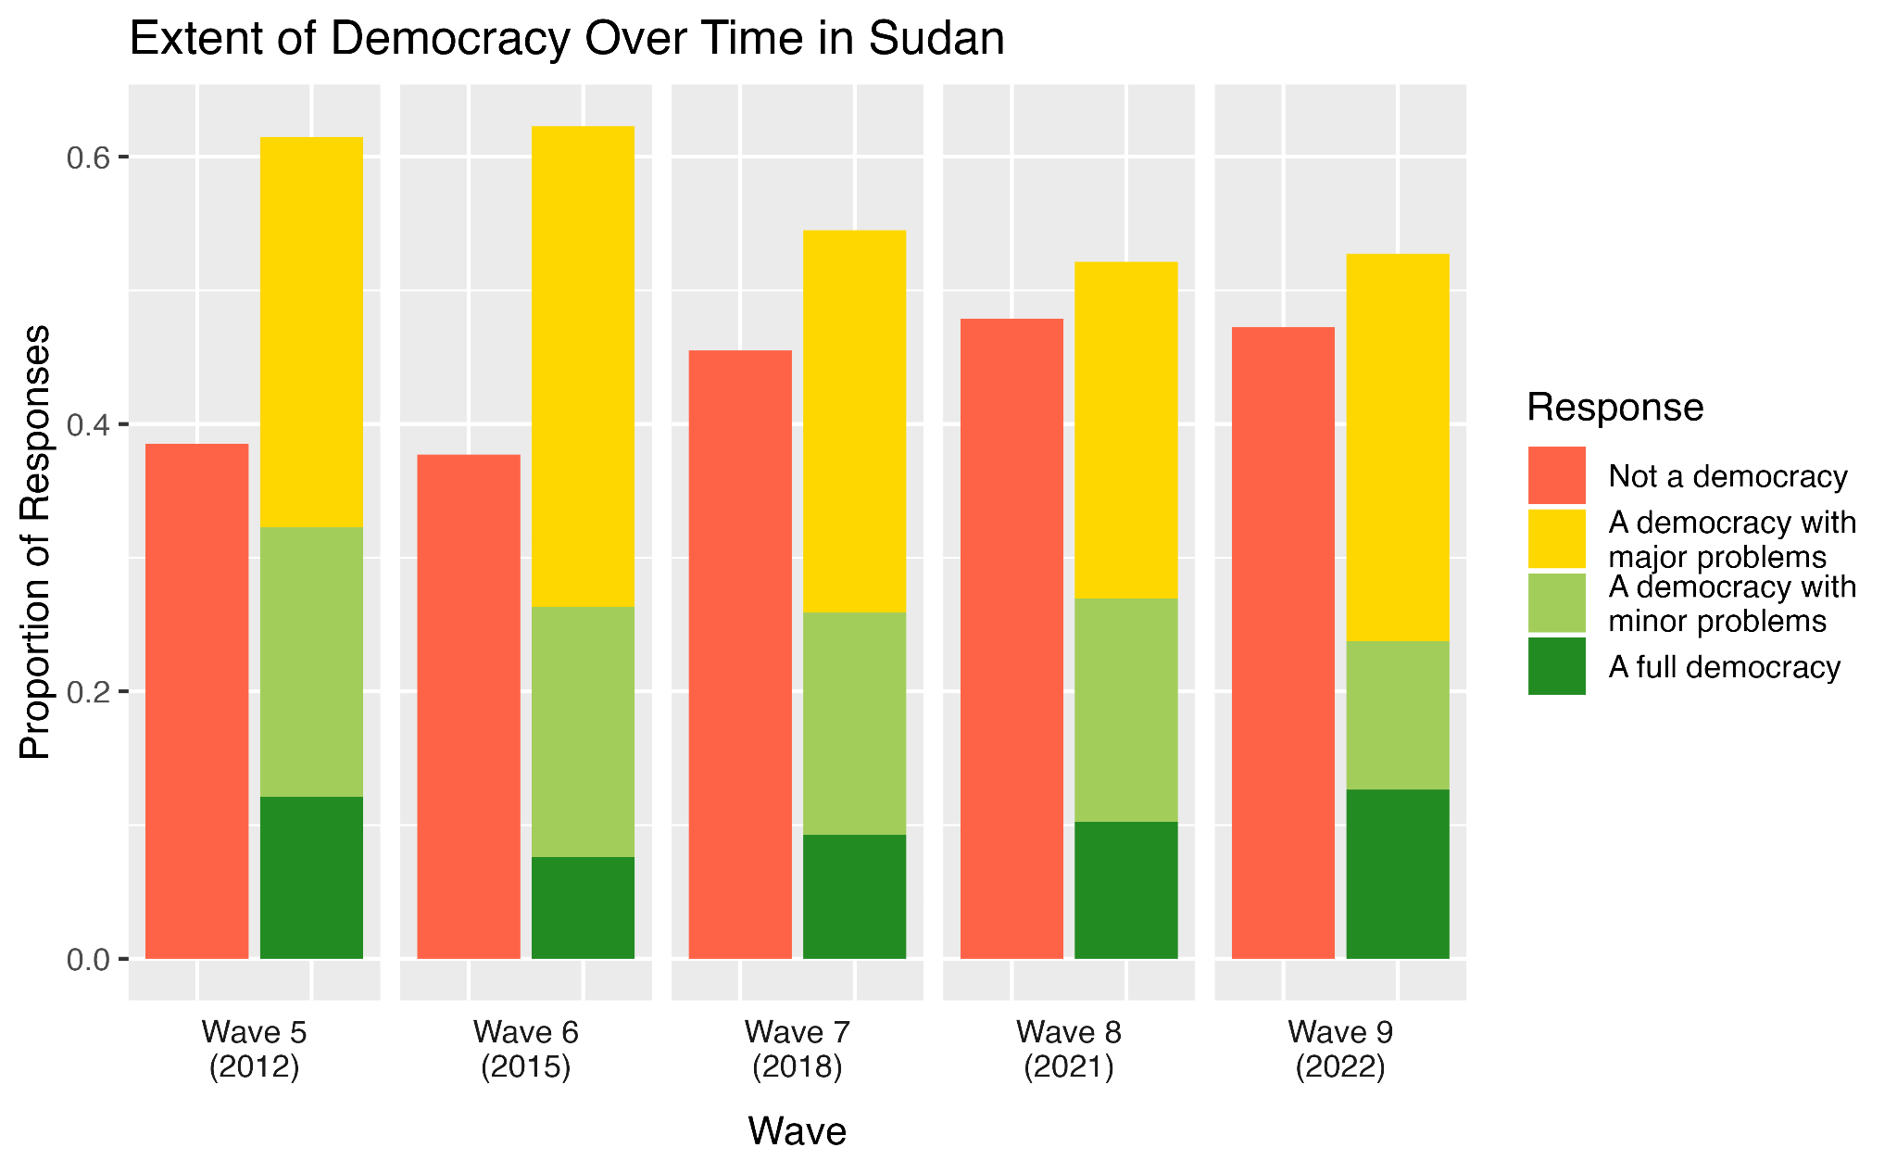
Sudan is becoming more and more undemocratic
Notes:
stable support for democracy although majority is not satisfied

Slide 9
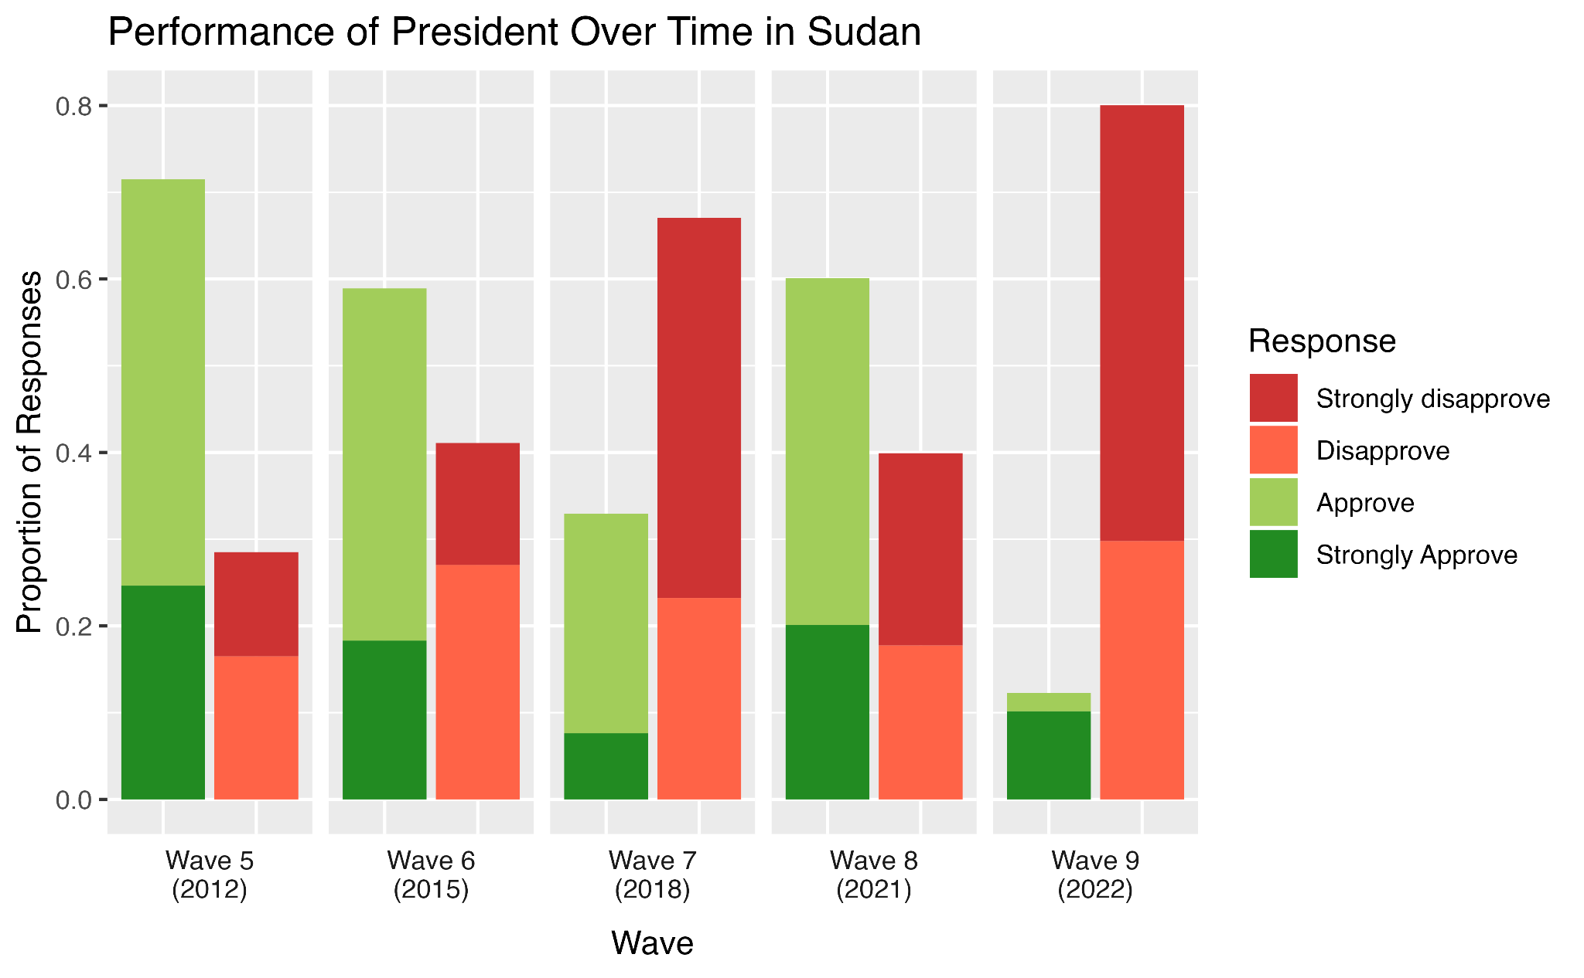
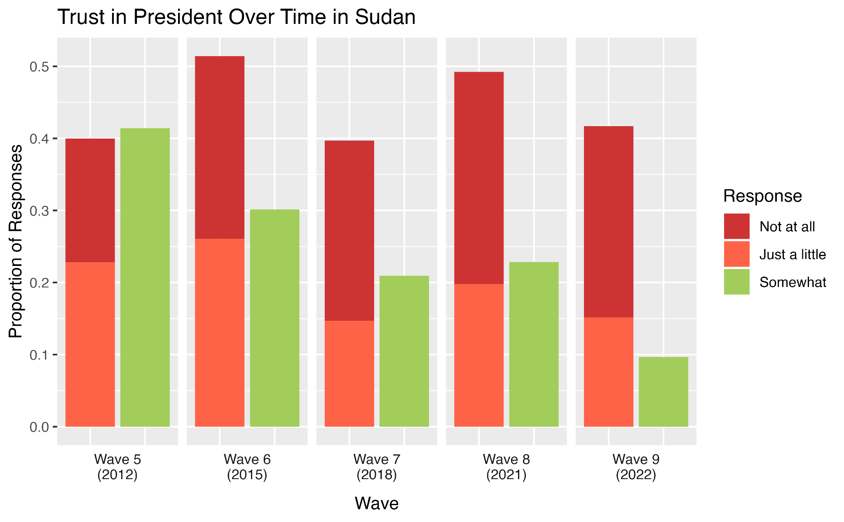
Trust in president and approval of performance decreasing

Slide 10
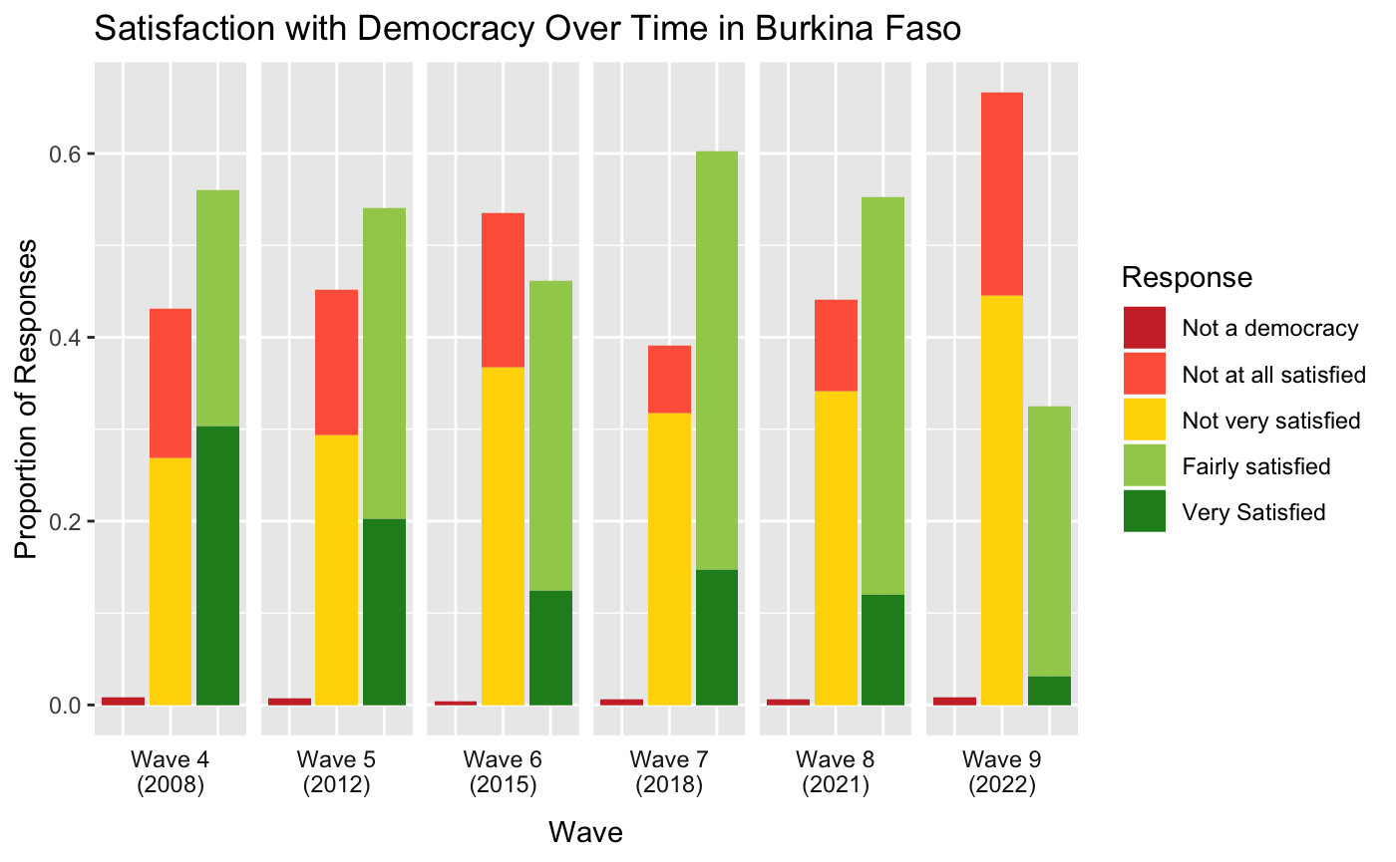
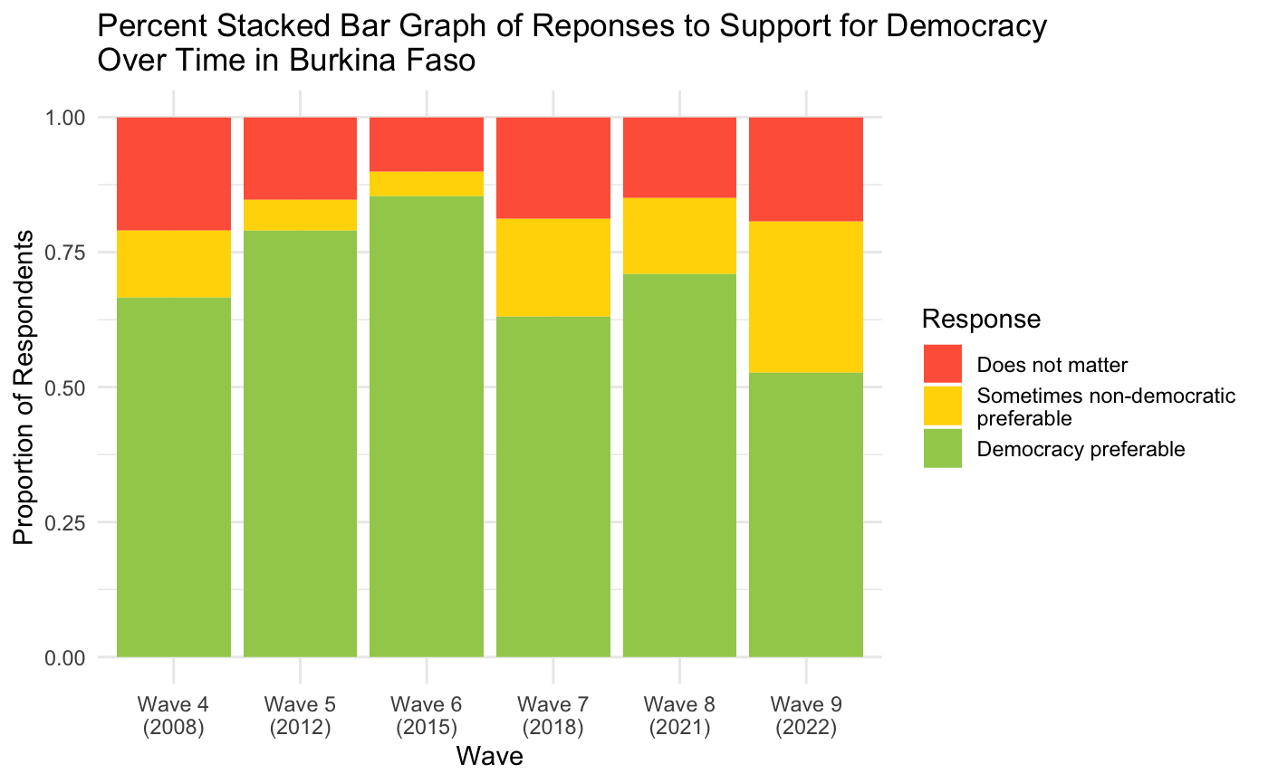
People are less satisfied with democracy and are starting to prefer democracy less in Burkina Faso

Slide 11
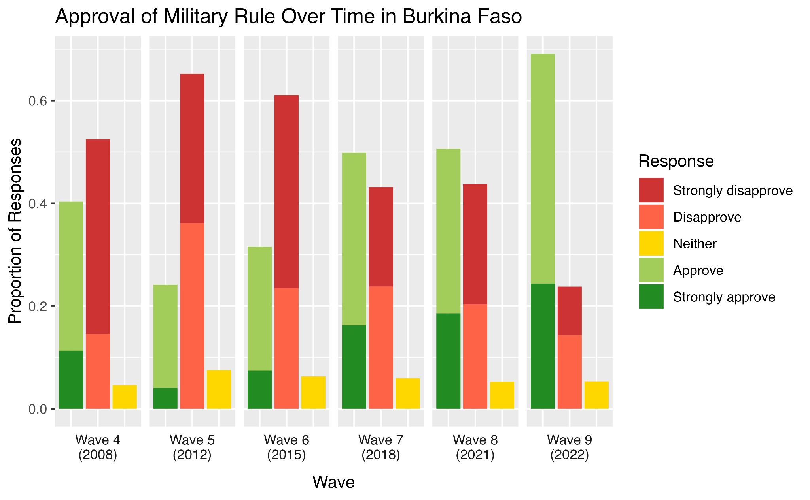
Approval for military rule on the rise since 2012

Slide 12
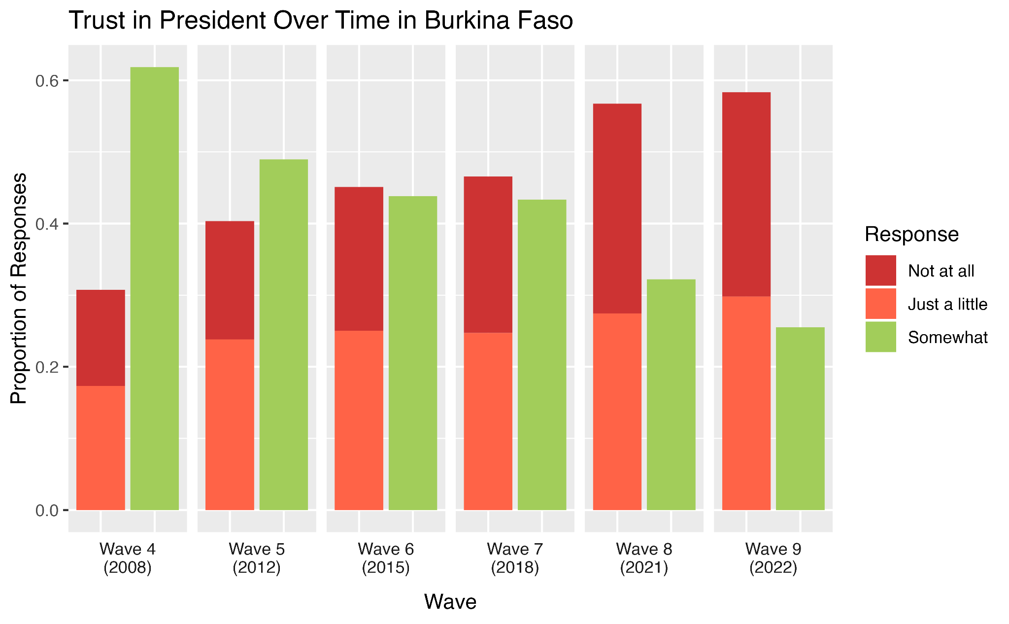
Rising negative and falling positive opinions of trust in president

Slide 13
Tuki’s Study on Niger’s Opinions of a Military Govt
Original Study
Wave 9 of Afrobarometer survey data
Linear regression analysis through 7 models
Three key variables:
corruption index
deprivation index
political instability
Nigerians do not have a strong aversion towards military rule
Positive correlation with political instability and negative correlation with socioeconomic deprivation
Extension of Study / Replication
Apply original study to Mali
Cleaning all initial data
Gathering all external data
political instability data
nighttime light data (QGIS)
Performing linear regression analysis
Notes:
(marking necessary responses as missing)

Slide 14
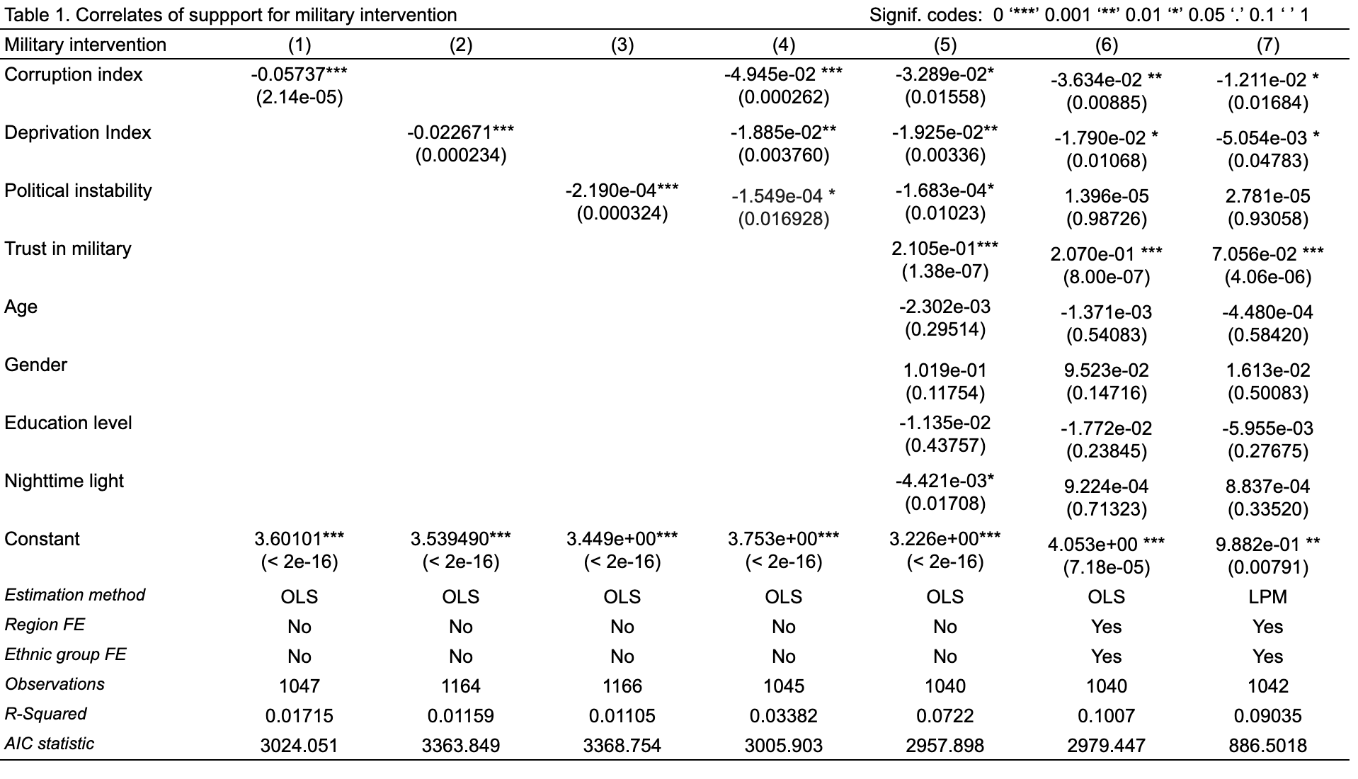
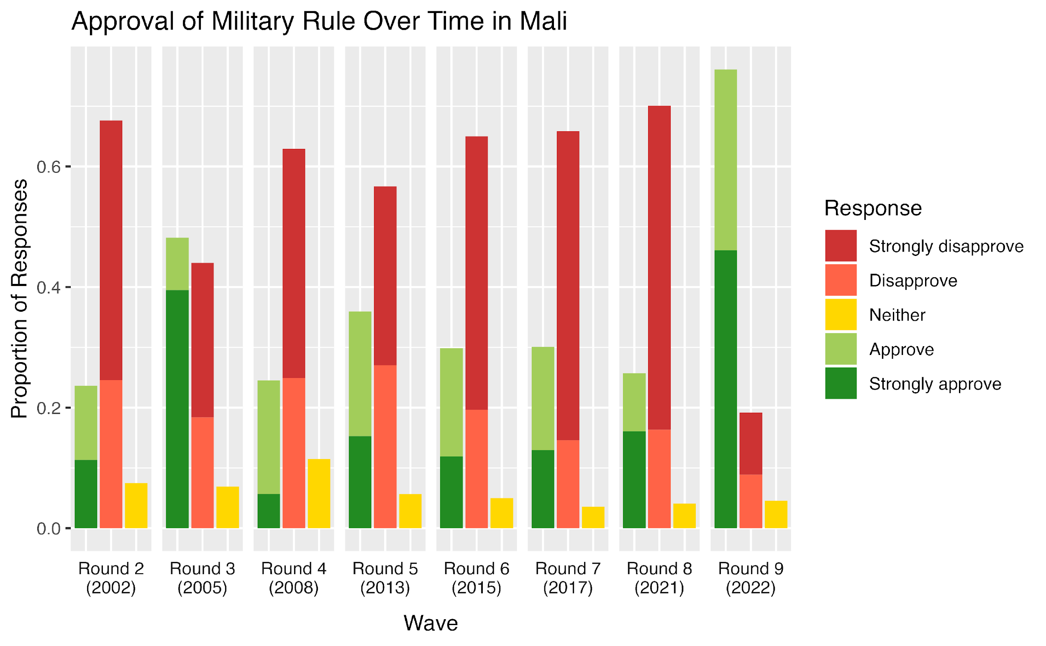
Linear Regression Results
Notes:
Model 1 shows significance at the 0.001 significance level and carries a positive sign. This shows that perceived corruption negatively correlates with military support and means that corruption does not weaken support for the current government and does not prompt people to support military intervention. This is not the same conclusion Tuki sees with Niger, where the opposite relation occurs.
Model 2 shows that socioeconomic deprivation negatively correlates with military support, at a 0.001 significance level.
Model 3 shows that political instability negatively correlates with military support, at

Slide 15
My case study has three key implications
1
Opinions of democracy are changing for worse, possibly tied to the opinions of presidents in recent years
Mali and Burkina Faso experienced increasing support for military rule
2
Perceived corruption and socioeconomic deprivation are notably negatively correlated with support for military intervention
3

